Slide 1
Umbraco Packages These are a few of my favourite things
By Paul Seal from Moriyama

Slide 2


Who am I?
My Favourite Packages
Paul Seal
Moriyama
Umbraco Certified Master 5 x Umbraco MVP YouTuber 😃
Umbraco Gold Partner Contributing Gold Partner Umbraco and Azure Specialists ⭐

Slide 3
About this talk
My Favourite Packages
1
2
3
Packages
Solving Problems
Use Cases
I wanted to share my favourite Umbraco 9+ packages with you
Explain what problems can be solved when using these packages.
I’ve prepared demos for each of the packages to show you real use cases

Slide 4
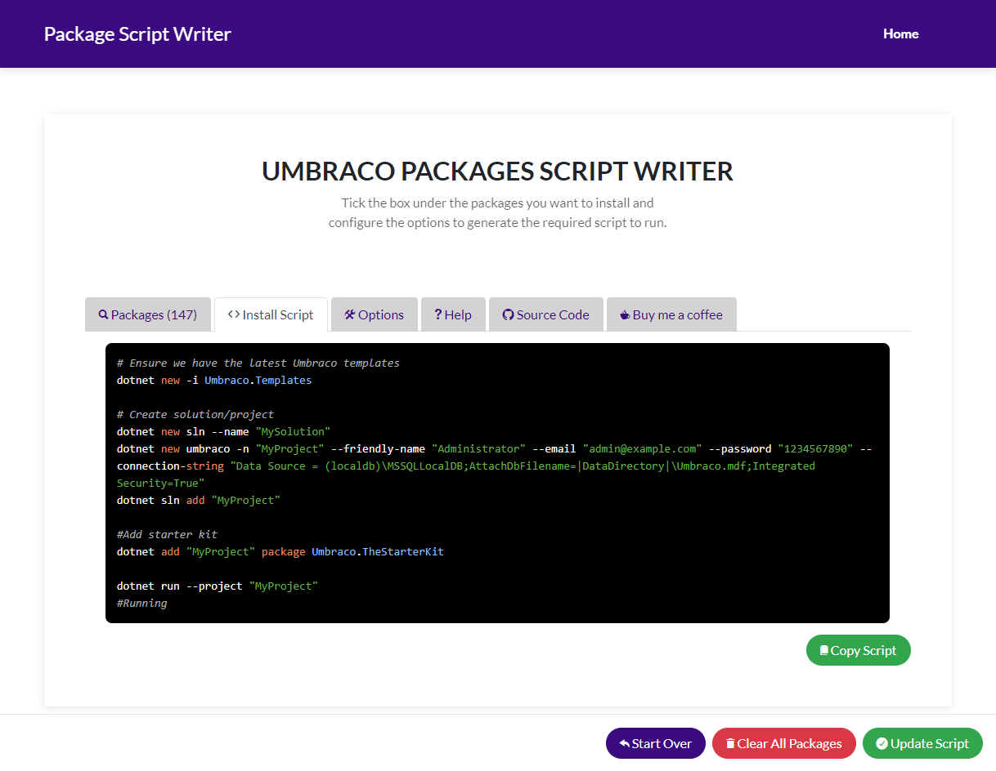

Package Script Writer
My Favourite Packages
https://psw.codeshare.co.uk

Slide 5
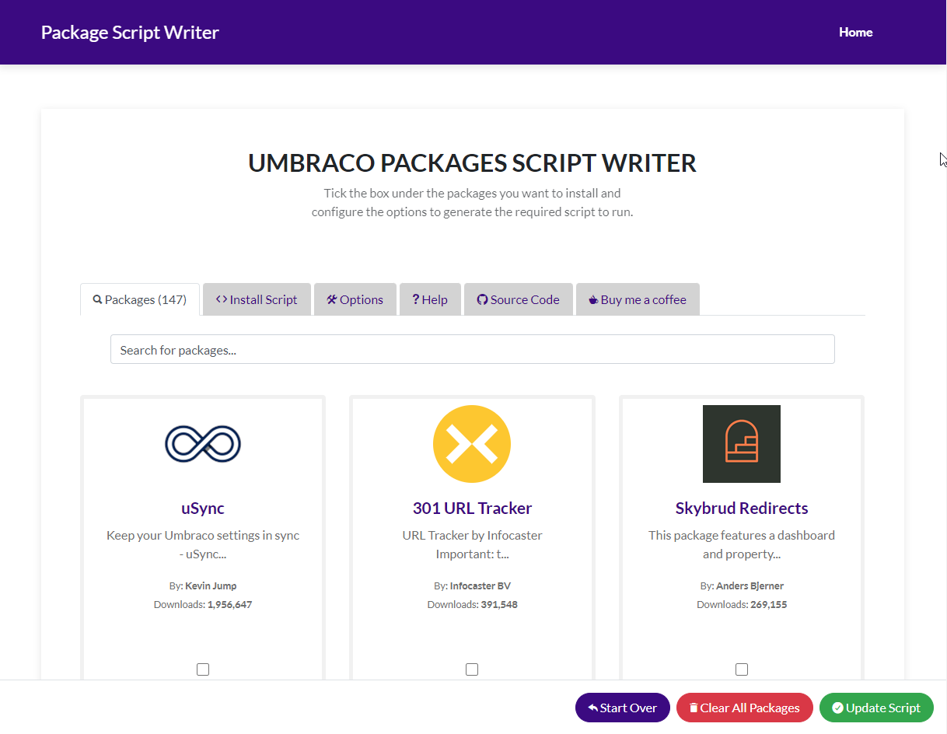
Search Umbraco Packages
My Favourite Packages

Slide 6
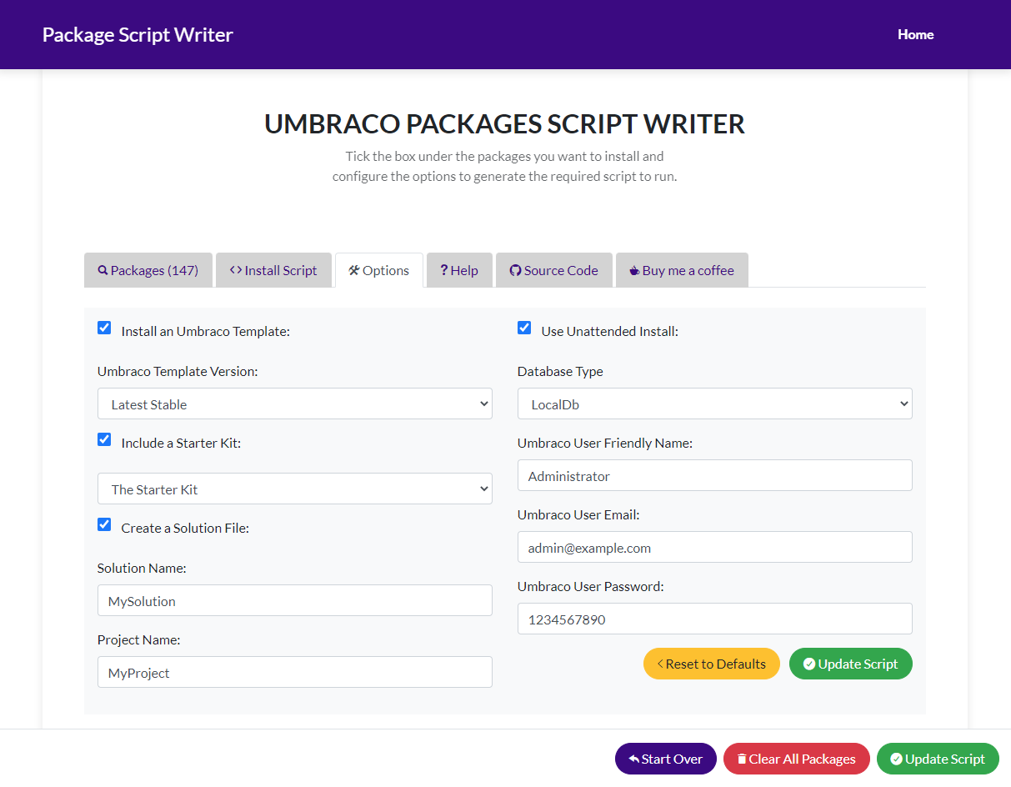
Configure Options
My Favourite Packages

Slide 7
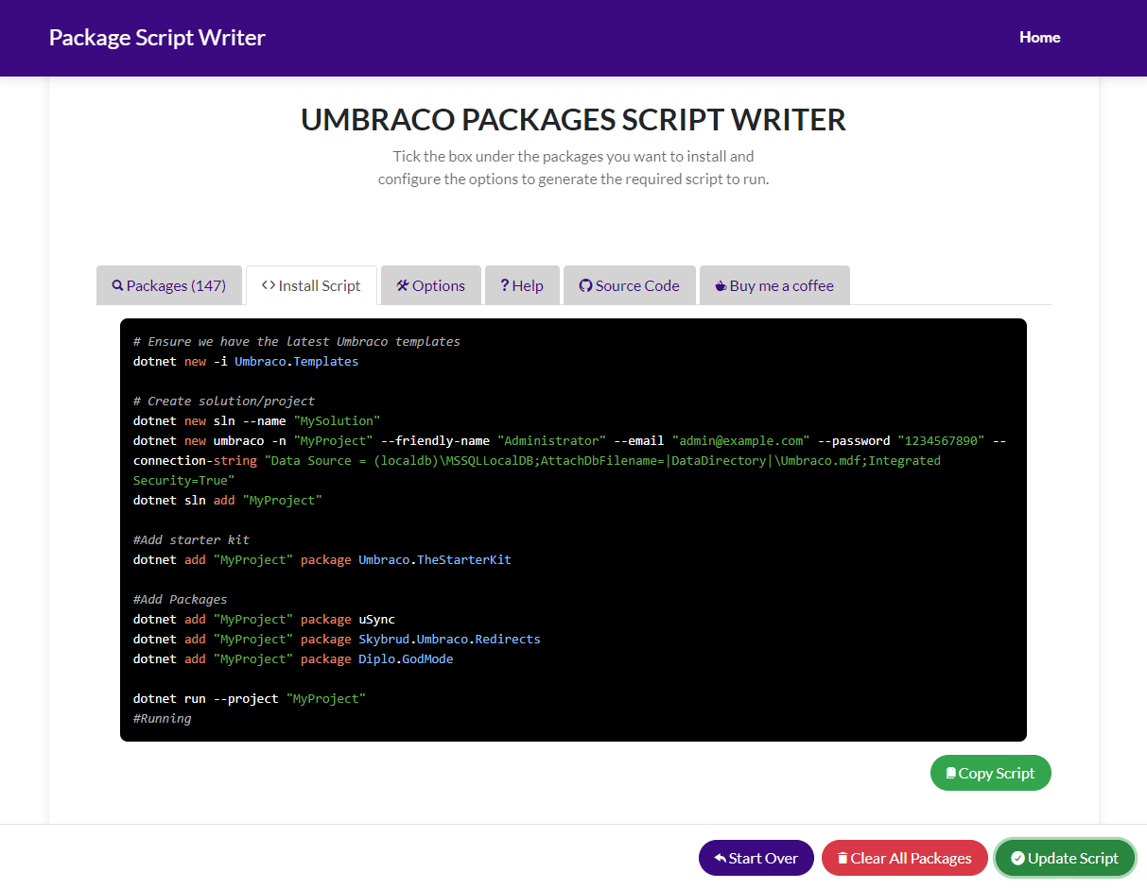
Copy and Paste the Script
My Favourite Packages

Slide 8
Bookmark Favourite Scripts
My Favourite Packages
1
2
3
Edit
Save
Reload
When you edit the options or choose packages the query string is updated
You can save your favourite scripts as bookmarks because the data is saved in the query string
When you load the page with a query string, it generates the relevant script

Slide 9

Demo Time
My Favourite Packages
Notes:
Install clean starter kit on v10

Slide 10

uSync Complete
My Favourite Packages
By Kevin Jump

Slide 11
What is uSync Complete
My Favourite Packages
Version Control
Publishing
Exporter
More
Gives you the ability to version control the database settings in your Umbraco website
Pull and Push Content, Media and Settings
Create Sync-Packs to group changes to export and import

Slide 12

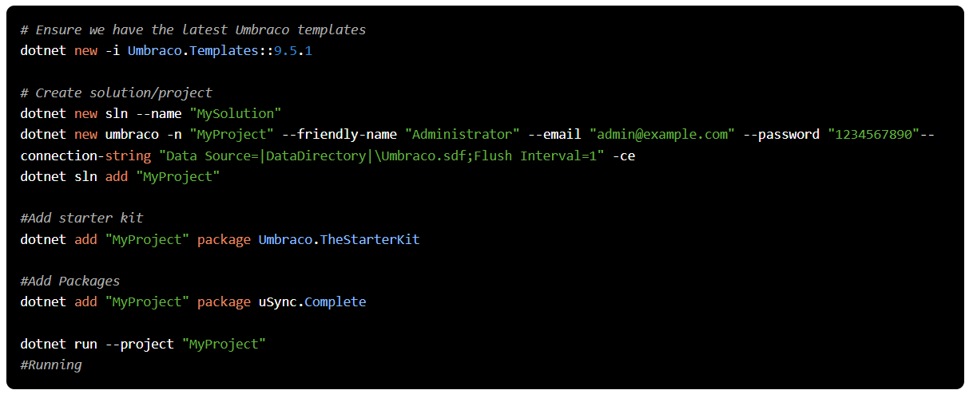
How to Install uSync Complete
My Favourite Packages
https://codeshare.co.uk/links/cg22/psw-usync/

Slide 13
Demo Time
My Favourite Packages
Notes:
Run v8 site
Clean v9 site
Import v8 uSync to v9 site
Add media items

Slide 14

Skybrud Redirects
My Favourite Packages
By Anders Bjerner

Slide 15
What is Skybrud Redirects?
My Favourite Packages
Redirect Management
Dashboard
Content App
More
Making the management of redirects in your Umbraco website super easy
Gives you a dashboard to manage your redirects
Give you a content app to see and manage the redirects for the current content or media item
Notes:
Unpublish Product Page
Redirect To No Longer Available
Show Content App
About Us - Business Report
Show Event Example

Slide 16

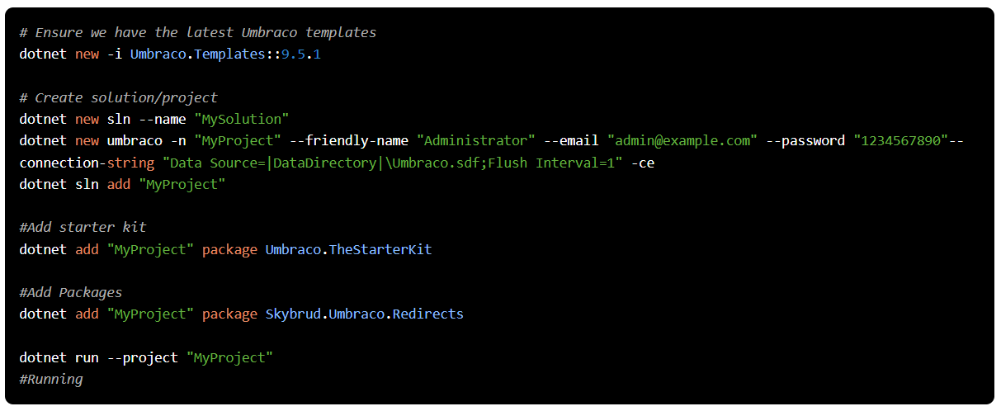
How to Install Skybrud Redirects
My Favourite Packages
https://codeshare.co.uk/links/cg22/psw-skybrud-redirects/

Slide 17
Demo Time
My Favourite Packages
Notes:
Unpublish Product Page
Redirect To No Longer Available
Show Content App
About Us - Business Report
Show events

Slide 18

Diplo God Mode
My Favourite Packages
By Dan Booth

Slide 19
What is Diplo God Mode?
My Favourite Packages
Usage Browser
Utilities
Diagnostics
More
You can find out so much about the document types, datatypes, and templates including which ones are in use or not
Clear caches, warm up the templates, restart the website and more
Information about your Umbraco setup and the server it is running on

Slide 20

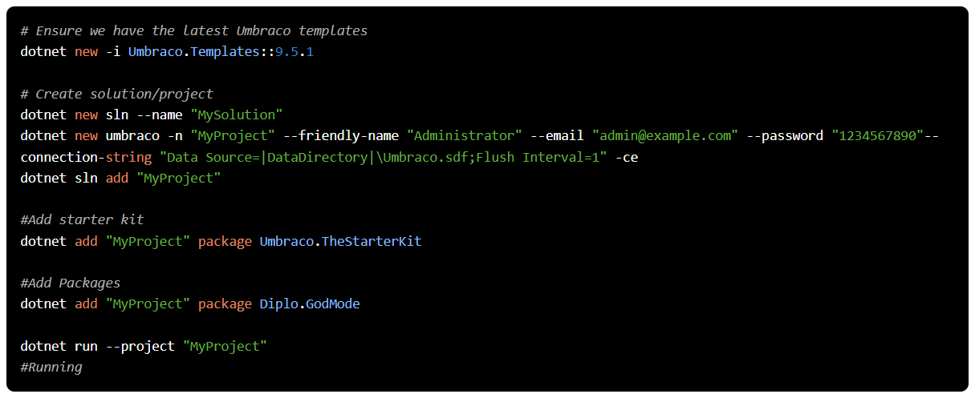
How to Install Diplo God Mode
My Favourite Packages
https://codeshare.co.uk/links/cg22/psw-diplo-god-mode/

Slide 21
Demo Time
My Favourite Packages
Notes:
Fix Templates
Utilities
Diagnostics
Clean up Data Types

Slide 22
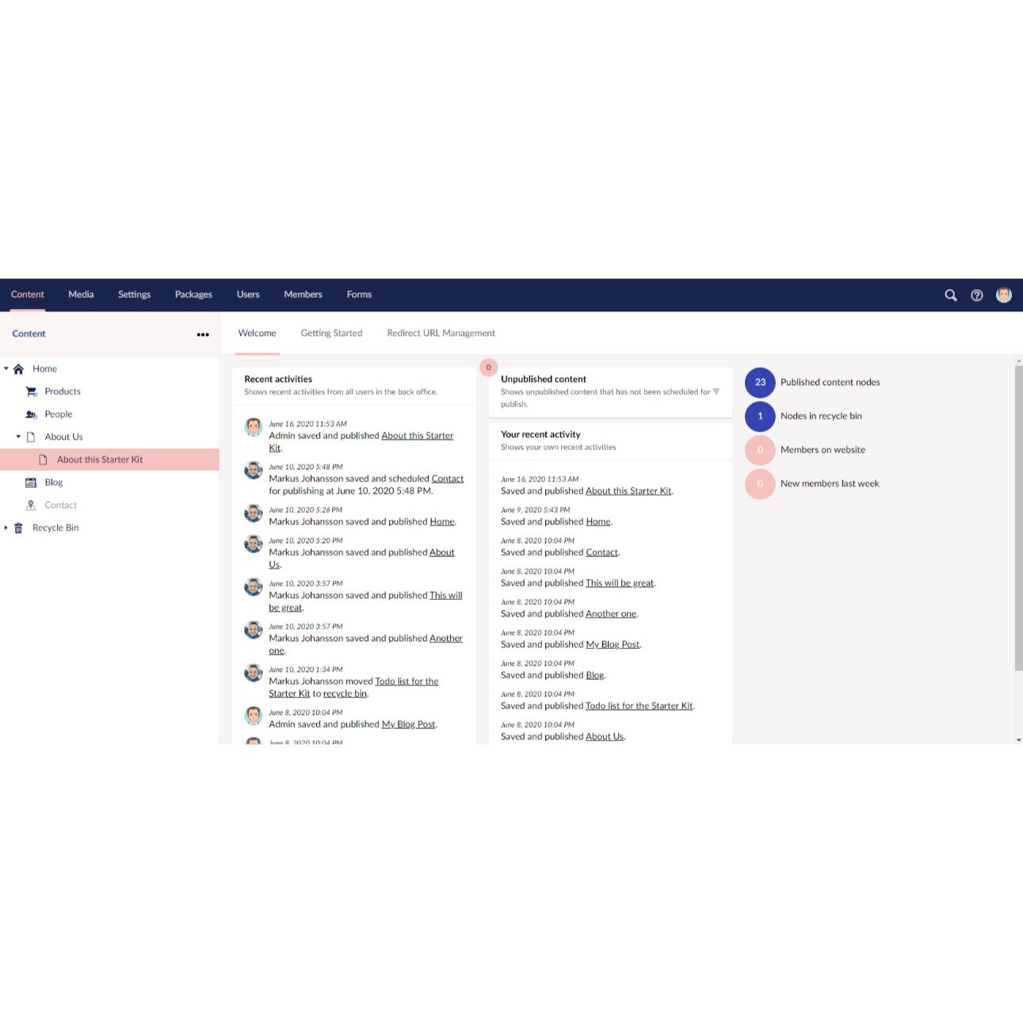
The Dashboard
My Favourite Packages
By Markus Johansson

Slide 23
What is The Dashboard?
My Favourite Packages
Clean Dashboard
Relevant Information
Links
More
An alternative to the default dashboard that comes with Umbraco
Gives you relevant information about what has been happening in your Umbraco site
It gives you links to different sections such as the recycle bin

Slide 24

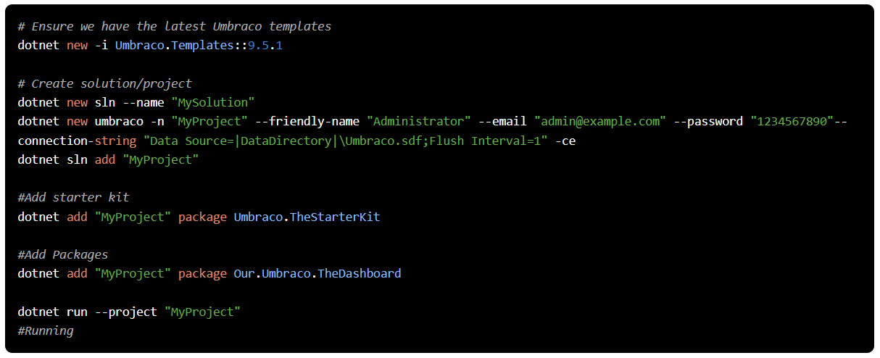
How to Install The Dashboard
My Favourite Packages
https://codeshare.co.uk/links/cg22/psw-the-dashboard/

Slide 25
Demo Time
My Favourite Packages
Notes:
Show the dashboard
Click the links to recycle bin etc
Turn off the default dashboard
Show Shift + F2 Add New Extension

Slide 26

Editor Notes
My Favourite Packages
By Marc Goodson

Slide 27
What is Editor Notes?
My Favourite Packages
Descriptions
Eye Catching
Different Modes
More
Gives you the ability to provide more detailed descriptions for properties.
You can change the style of the notes to make them stand out or not.
There are different modes you can use to display your notes including: inline, popout, accordion

Slide 28

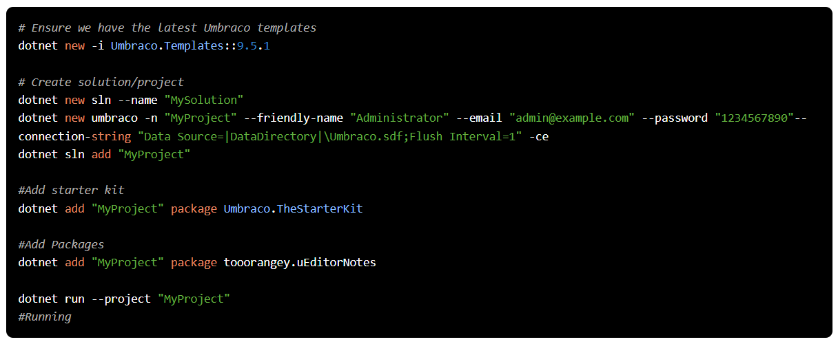
How to Install Editor Notes
My Favourite Packages
https://codeshare.co.uk/links/cg22/psw-ueditor-notes/

Slide 29
Demo Time
My Favourite Packages
Notes:
Hero
Footer
Theme

Slide 30

Contentment
My Favourite Packages
By Lee Kelleher

Slide 31
What is Contentment?
My Favourite Packages
Property Editors
Editing Experience
Developer Experience
More
Set of property editors and data sources that you can customise
These beautiful editors make for a fantastic editing experience
Components such as the Data List Editor make it a dream package for developers

Slide 32

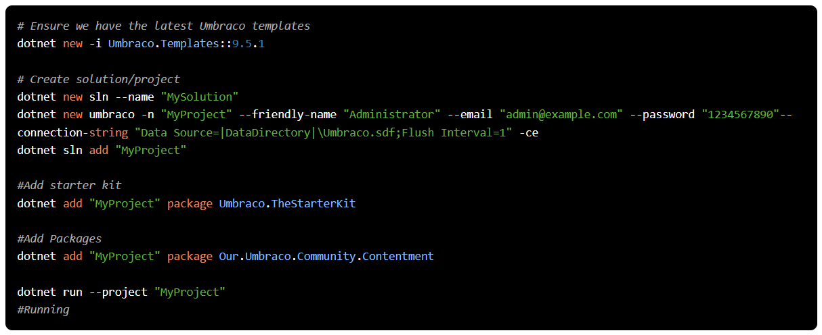
How to Install Contentment
My Favourite Packages
https://codeshare.co.uk/links/cg22/psw-contentment/

Slide 33
Demo Time
My Favourite Packages
Notes:
Alternate Href Lang
Author Picker
User Defined List

Slide 34
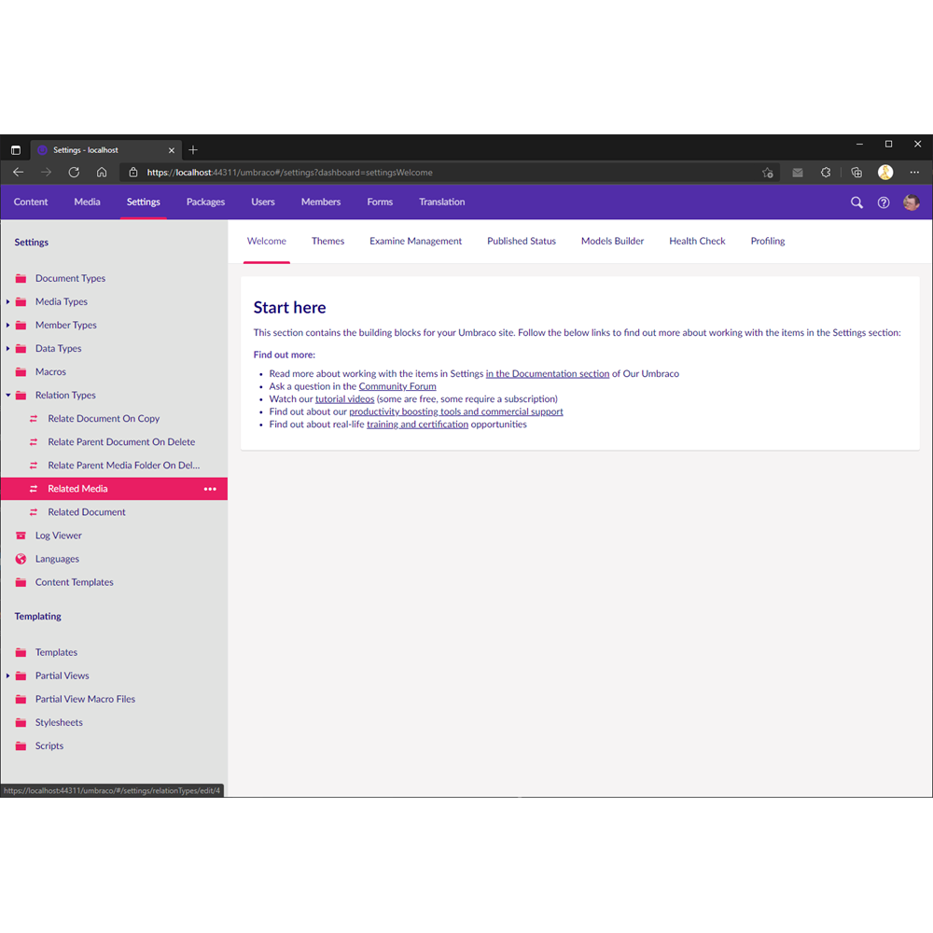
Backoffice Themes
My Favourite Packages
By Kevin Jump

Slide 35
What is Backoffice Themes?
My Favourite Packages
Themes
Create your own themes
The user can change the theme of the site
Add your own themes by creating stylesheets in the themes folders

Slide 36

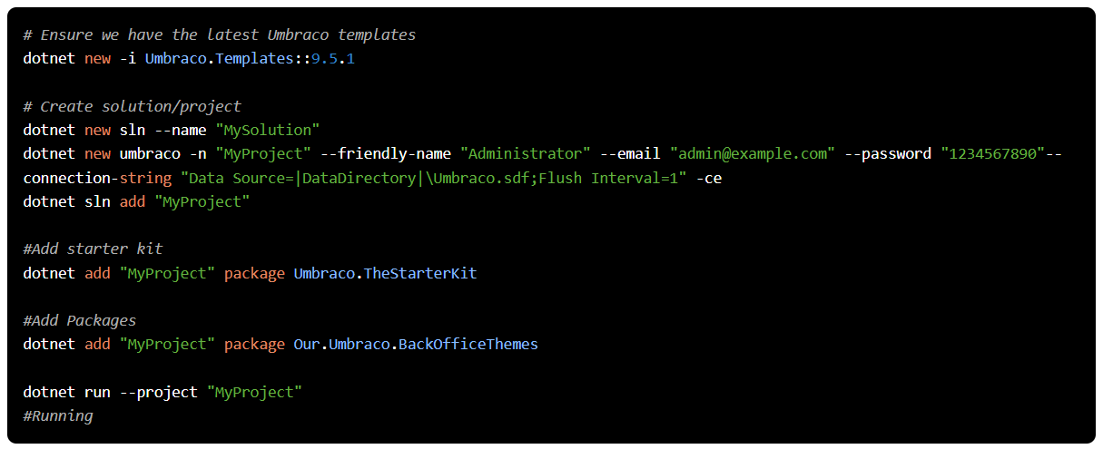
How to Install Backoffice Themes
My Favourite Packages
https://codeshare.co.uk/links/cg22/psw-backoffice-themes/

Slide 37
Demo Time
My Favourite Packages
Notes:
User changing theme
Admin change server theme

Slide 38

Our Umbraco Tag Helpers
My Favourite Packages
By Warren Buckley

Slide 39
What is Our Umbraco Tag Helpers?
My Favourite Packages
Tag Helpers
A collection of tag helpers built by the Umbraco Community

Slide 40

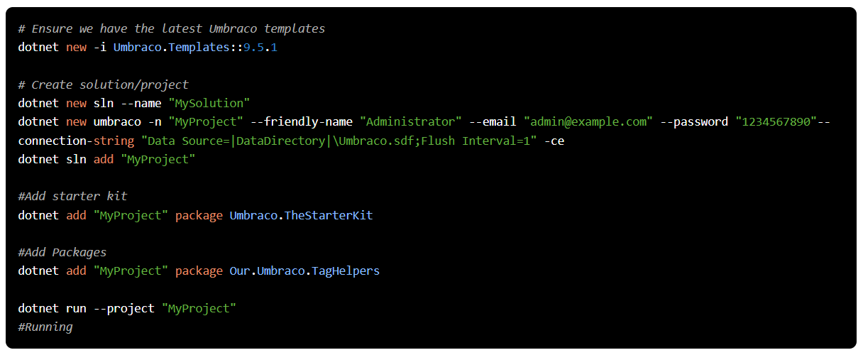
How to Install Umbraco Tag Helpers
My Favourite Packages
https://codeshare.co.uk/links/cg22/psw-tag-helpers/

Slide 41
Demo Time
My Favourite Packages
Notes:
View Imports
Dictionary in footer
SVG for logo
Edit Link

Slide 42

Hot Chilli Page Not Found Manager
My Favourite Packages
By Nik Rimington

Slide 43
What is Hot Chilli Page Not Found Manager?
My Favourite Packages
404 Handling
Multiple 404 pages
Easily configure a 404 page for your site without having to touch any code
You can add different 404 pages for different sections of the site

Slide 44

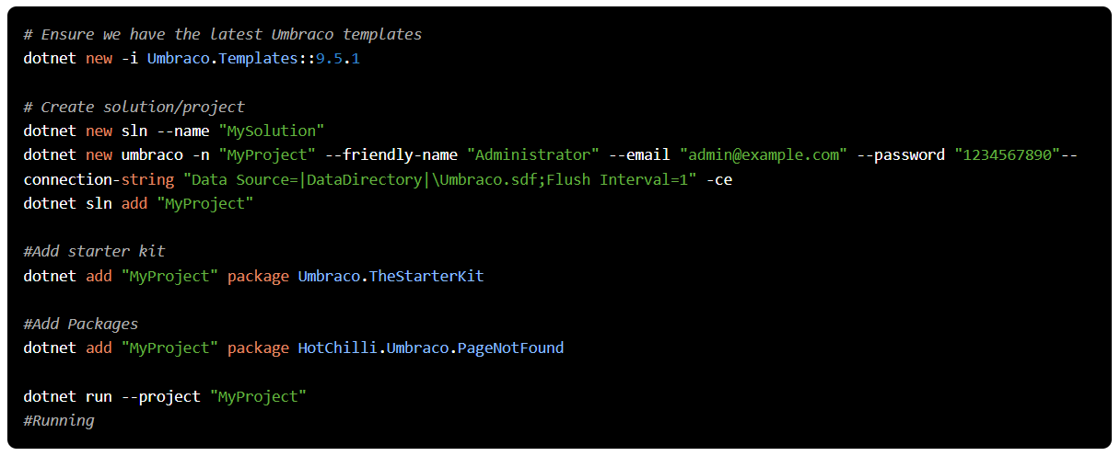
How to Install Hot Chilli Page Not Found Manager
My Favourite Packages
https://codeshare.co.uk/links/cg22/psw-page-not-found/

Slide 45
Demo Time
My Favourite Packages
Notes:
404 page
Product Page Not Found

Slide 46

Konstrukt
My Favourite Packages
By Matt Brailsford

Slide 47
What is Konstrukt?
My Favourite Packages
UI Builder
Fluent API
Property Editors
More
Automatically creates the relevant UI to manage custom content
Uses a fluent API for an easy way to define the configuration
Gives you the ability to reuse the same property editors that you would normally use in your Umbraco site.
Notes:
CodeShare show real blog post
Show virtual blog post
Show virtual blog post
Show editing experience

Slide 48

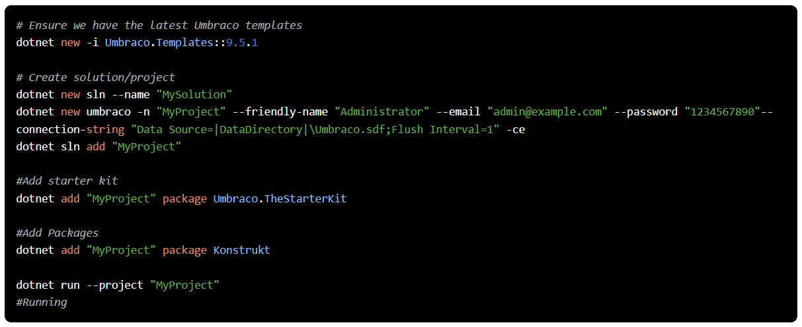
How to Install Konstrukt
My Favourite Packages
https://codeshare.co.uk/links/cg22/psw-konstruct/

Slide 49
Demo Time
My Favourite Packages
Notes:
CodeShare show real blog post
Show virtual blog post
Show virtual blog post
Show editing experience

Slide 50
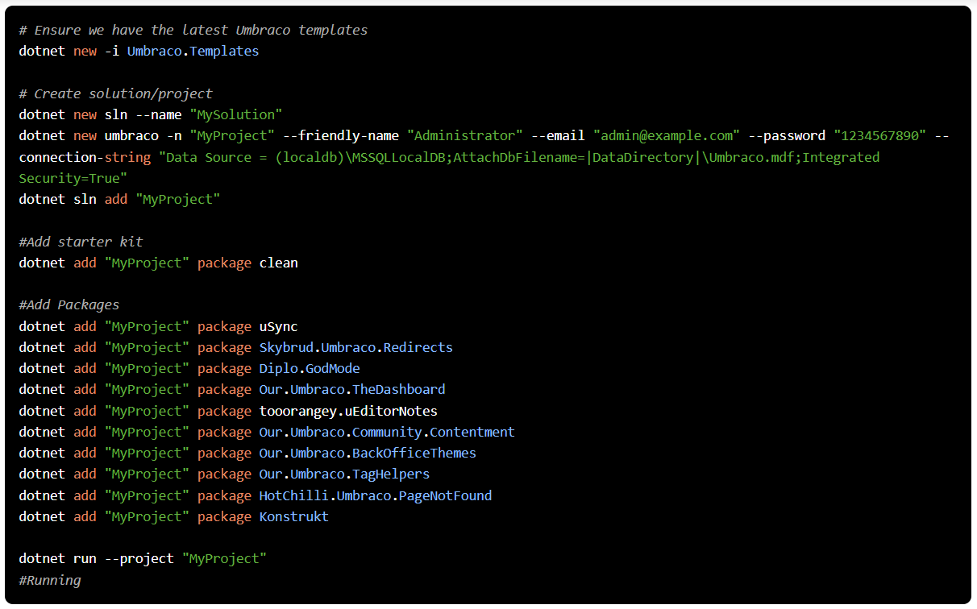

All Package In One Script
My Favourite Packages
https://codeshare.co.uk/links/cg22/psw-combined/

Slide 51
Summary
My Favourite Packages
So many great packages
Try them out for yourself
Go and use the Package Script Writer tool

Slide 52

Contact details
My Favourite Packages
Paul Seal
@CodeSharePaul codeshare.co.uk codeshare.co.uk/youtube

Slide 53

Contact details
My Favourite Packages
Moriyama
@moriyamaumbraco moriyama.co.uk

Slide 54
Package Script Writer
My Favourite Packages
https://psw.codeshare.co.uk

Slide 55

Demos Repository On GitHub
My Favourite Packages

Slide 56
Thank you!

